Slide 1






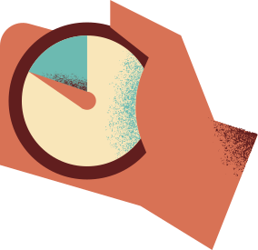



CAPSTONE PROJECT
Second one - one meeting
Presentation by Charushree Anil

Slide 2

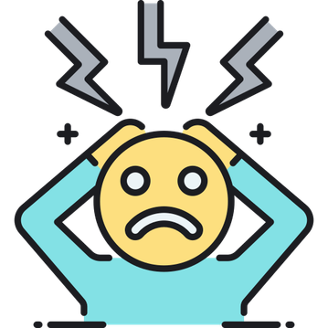
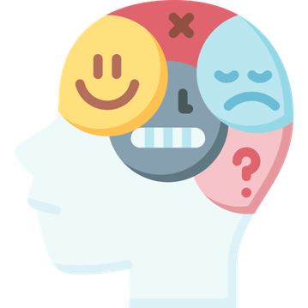
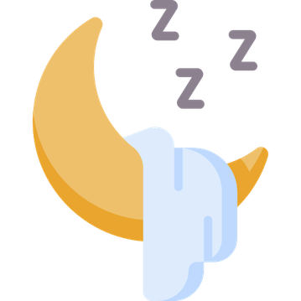
IMPACT OF LIFESTYLE HABITS ON ANXIETY ATTACK SEVERITY

Slide 3

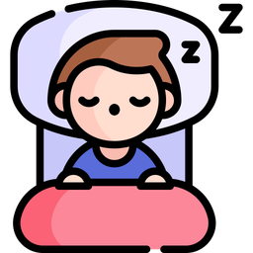


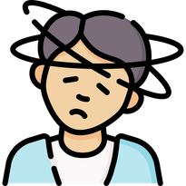


BACKGROUND
Anxiety attacks can be influenced by everyday habits like sleep, exercise, caffeine, and alcohol intake. This study explores how these lifestyle choices affect anxiety severity using real-world data. By analyzing patterns, we can uncover insights to help people manage anxiety better!

Slide 4
DATA
Dataset contains 12,000+ records detailing various factors related to anxiety attacks, including demographics, lifestyle habits, stress levels, and physiological responses. It is designed for data analysis, machine learning, and mental health research, helping to explore patterns, triggers, and potential correlations in anxiety disorders.
Key Features:
🧑‍🤝‍🧑 Demographics: Age, Gender, Occupation
🌙 Lifestyle Factors: Sleep, Physical Activity, Diet, Caffeine & Alcohol Intake
💓 Health Indicators: Heart Rate, Breathing Rate, Sweating, Dizziness
🧠 Psychological Factors: Stress Level, Family History, Therapy & Medication
⚠️ Anxiety Attack Severity: Scale from 1 to 10
Dataset link: link

Slide 5

DATA CLEANING
✅ Removed Unnecessary Columns: Dropped constant-value or irrelevant columns (e.g., Caffeine_Impact, Exercise_vs_Stress).
✅ Handled Missing Values Categorical Data: Filled missing values with the most frequent value (mode).Numerical Data: Replaced missing values with the median to avoid skewing the data.
✅ Standardized Categorical Variables
Label Encoding: Converted ordinal categorical variables (e.g., Gender, Age_Group, Medical_History) into numerical format.
One-Hot Encoding: Created dummy variables for non-ordinal categorical features (e.g., Medication, Smoking).
✅ Verified Data Integrity
    Checked for duplicate records.
    Ensured no missing values remained after preprocessing.
    Confirmed data types were appropriate for analysis.

Slide 6
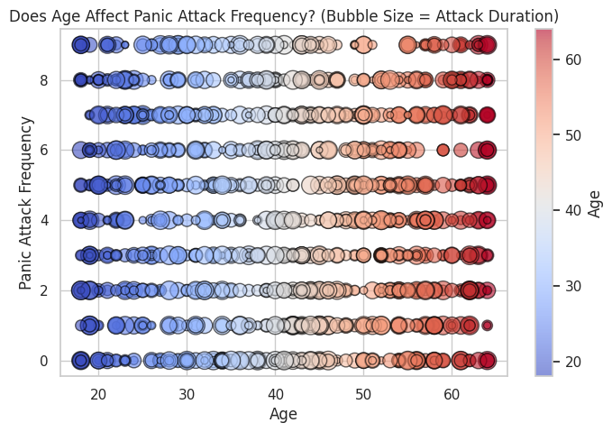
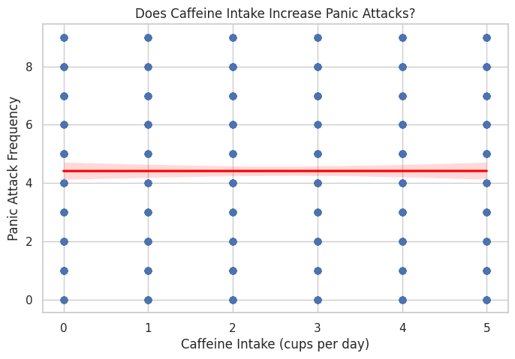
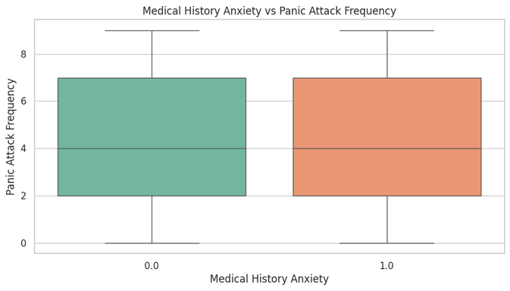
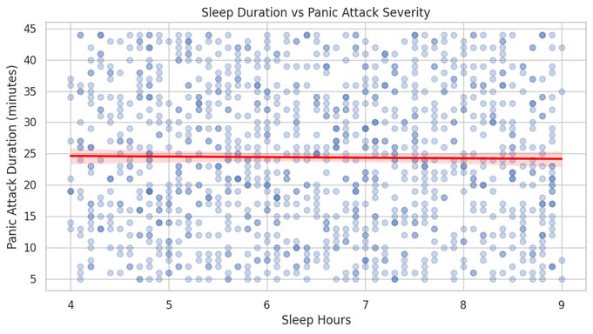
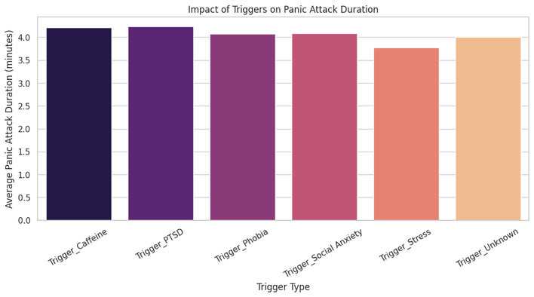

DATA VISUALIZATION

Slide 7
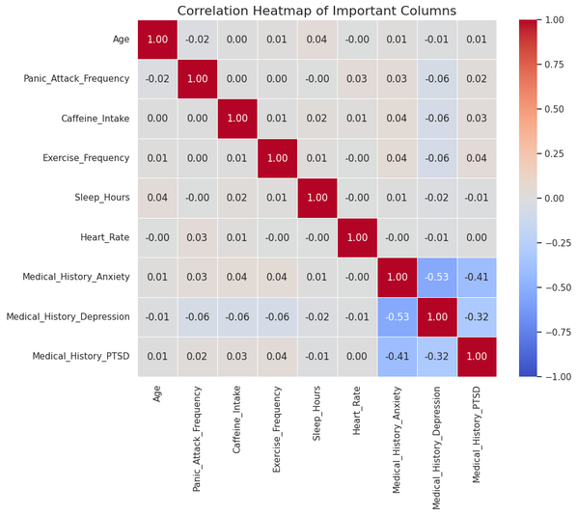
FINDINGS ON PANIC ATTACK FACTORS
Our analysis explored various factors that could influence panic attack frequency and severity, but no strong correlations were found.
  Age and Panic Attacks 🧓➡️😨: Age has no significant effect on how frequently panic attacks occur (correlation: -0.0168).
  Caffeine Intake ☕ and Panic Attacks: Drinking caffeine does not influence the number of panic attacks (correlation: 0.00036).
  Exercise and Panic Attacks 🏃‍♂️😌: Exercising more often doesn’t seem to lower panic attack frequency (correlation: 0.00118).
  Sleep Duration and Attack Severity 💤⏳: Getting more sleep does not significantly reduce panic attack duration (correlation: -0.0115).
  Triggers and Panic Attack Duration ⚠️: Stress, social anxiety, PTSD, and phobias may lead to longer panic attacks, but a deeper statistical analysis is needed to confirm.
  Medical History (Anxiety, Depression, PTSD) and Panic Attacks 🏥:A history of anxiety or PTSD shows a very weak positive correlation with panic attack frequency, while depression shows a very weak negative correlation.
These factors alone are not strong predictors of frequent or severe panic attacks.

Slide 8

CONCLUSION
  No single factor strongly predicts panic attacks.
  A combination of factors (like stress, mental health history, and sleep patterns) may be more useful for analysis.
  Further machine learning or statistical testing could help uncover hidden patterns.

Slide 9



THANK YOU

